Slide 1
Child Welfare Outcome Reporting
“Children in Foster Care”

Slide 2

Famous Quote by “Dr. Seuss

Slide 3
Data Source
Adoption and Foster Care Analysis and Reporting System (AFCARS)
www.acf.hhs.gov
Child Welfare Information Gateway
www.childwelfare.gov
www.cwoutcomes.acf.hhs.gov
Dr. Seuss quote
www.writtenreality.com
The Annie E. Case Foundation Kids Count Data Center
www.datacenter.kidscount.org
The National Child Abuse and Neglect Data System (NCANDS)
www.healthdata.gov & www.acf.hhs.gov
U.S. Census Bureau
https://www.census.gov
U.S. Department of Health and Human Services, Administration for children and Families, Administration on Children, Youth and Families
www.acf.hhs.gov

Slide 4
Child Welfare Outcome Reporting
The purpose of this presentation is to show the Child Welfare Outcomes Report, including performance on outcome measures and relevant context data. Child Welfare Outcomes Reports provide information on the performance of states in seven outcome categories. The Department identified these outcomes prior to the first Child Welfare Outcomes Report in close consultation with state and local child welfare agency administrators, child advocacy organizations, child welfare researchers, state legislators, and other child welfare experts. The outcomes used in the reports reflect widely accepted performance objectives for child welfare practice. The seven categories of outcome are listed below.
Reduce recurrence of child abuse and/or neglect.
Reduce the incidence of child abuse and/or neglect in foster care
Increase permanency for children in foster care
Reduce time in foster care to reunification without increasing reentry

Slide 5
Child Welfare Outcome Reporting
The report also includes findings of analyses conducted on performance across states and over time. Users of this data site will be able to explore the outcomes, demographic, and context data contained in the report and generate customer reports by state and year. Child Welfare Outcomes is a report that is published annually by the U.S. Department of Health and Human Services (the Department) to meet requirements of section 203(a) of the Adoption and Safe Families Act of 1997 (ASFA). ASFA amended section 479A of the Social Security Act to require an annual report on state performance.

Slide 6
Child Welfare Outcome Reporting
This data site presents data collected and analyzed for the annual Child Welfare Outcomes (CWO) Report. The CWO data site allows for significantly faster release of these data than is possible via the publication of the full Report. The data site features AFCARS and NCANDS data that have been reviewed and approved by the states for inclusion in the Report. In addition to state-level outcome measures data, the data site contains additional context data regarding child maltreatment, caseworker visits, and alternate race and ethnicity breakdowns.
A full list of the outcomes and measures reported on by the CWO Report can be found here: Outcomes and Measures.pdf

Slide 7
Child Welfare Outcome Reporting
This Report also uses child population data, which are provided by the U.S. Census Bureau on an annual basis. Total child population estimates are derived by calculating expected population change from the most recent decennial census data. Child poverty data are from the Census Bureau's American Community Survey, an ongoing survey that annually samples a small percentage of the population to provide communities with information relevant to their service provision and investments.
A summary of the specific data elements used to calculate context data and each outcome measure in the CWO Report can be found here: Data Sources and Elements.pdf

Slide 8
Child Welfare Outcome Reporting
In the CWO Report, two separate national medians were computed for each measure. In the yearly Range of State Performance tables, national medians are calculated using data from all states that met the relevant data-quality thresholds for that particular year only. In the Median State Performance and Change in Performance Over Time tables, national medians are calculated only using data from the states that met the relevant data-quality thresholds for all the relevant FYs. This is done to provide a more accurate calculation of change over time. A state whose data did not match mA summary of the data quality criteria used, including a list of states excluded from each outcome measure, can be found here: CWO Data Quality Definitions and Exclusions.pdf .

Slide 9
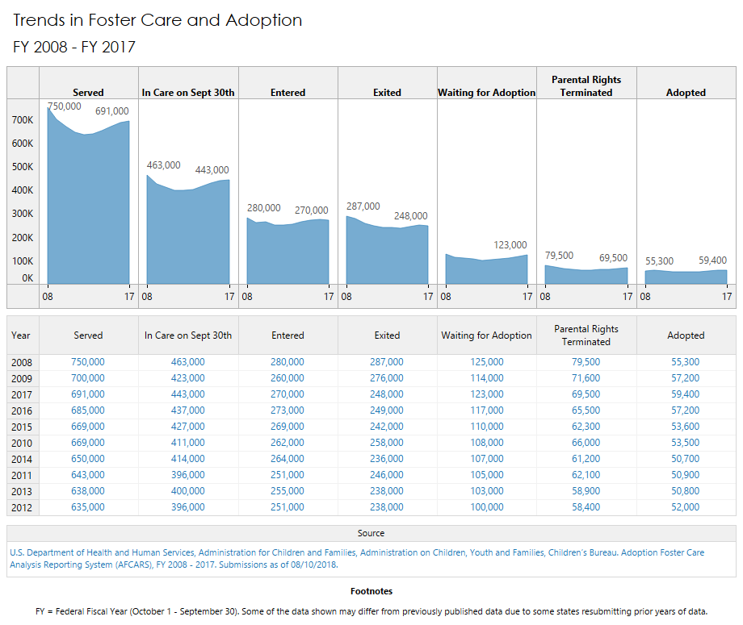
National Trends in Foster Care

Slide 10
National Trend vs DMV Trend
Maryland
District of Columbia
Virginia

Slide 11
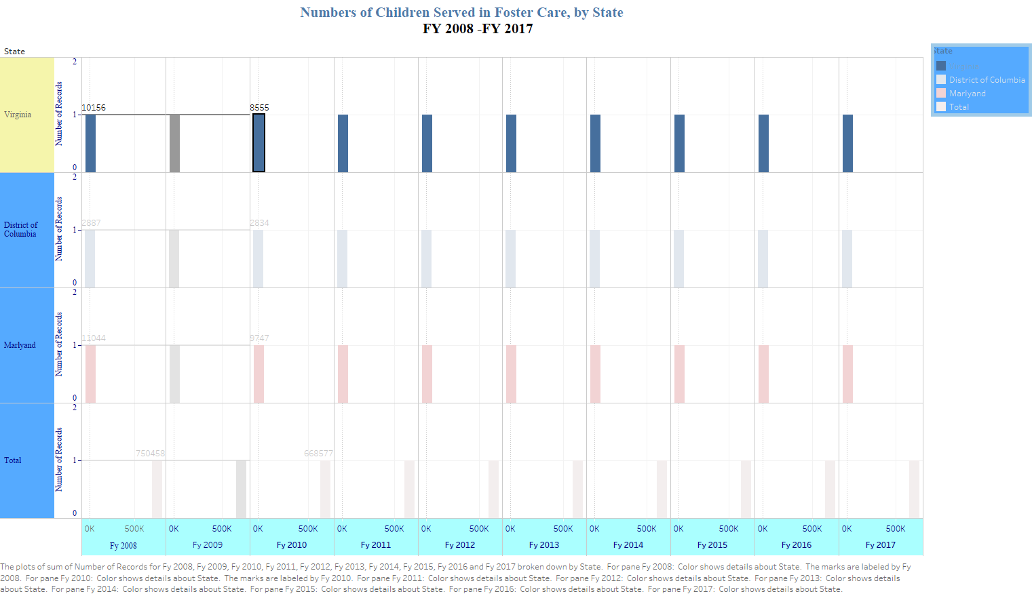

Slide 12
Race & Ethnicity View
The importance of the relationship of the information.

Slide 13
Maryland
General Child Population (Census Bureau) 3
 | 2013 | 2014 | 2015 | 2016 | 2017
Total children under 18 years | 1,345,681 | 1,348,756 | 1,348,094 | 1,348,377 | 1,347,506
Race/ethnicity (%) ⁴
Alaska Native / American Indian | 0.2 | 0.2 | 0.2 | 0.2 | 0.2
Asian | 5.8 | 5.9 | 6.0 | 6.2 | 6.3
Black | 31.5 | 31.3 | 31.2 | 31.1 | 30.9
Native Hawaiian / Other Pacific Islander | <.1 | <.1 | <.1 | <.1 | <.1
Hispanic (of any race) | 12.8 | 13.5 | 14.1 | 14.7 | 15.3
White | 44.8 | 44.1 | 43.4 | 42.8 | 42.2
Two or more races | 4.8 | 4.9 | 5.0 | 5.1 | 5.1
Child population in poverty (%) | 13.6 | 13.0 | 13.2 | 12.7 | 12.0

Slide 14
District Of Columbia
General Child Population (Census Bureau) 3
 | 2013 | 2014 | 2015 | 2016 | 2017
Total children under 18 years | 111,698 | 115,054 | 118,353 | 120,911 | 124,492
Race/ethnicity (%) ⁴
Alaska Native / American Indian | 0.2 | 0.2 | 0.1 | 0.1 | 0.1
Asian | 2.0 | 2.0 | 2.0 | 2.1 | 2.3
Black | 60.1 | 58.8 | 57.7 | 56.0 | 54.3
Native Hawaiian / Other Pacific Islander | <.1 | <.1 | <.1 | <.1 | <.1
Hispanic (of any race) | 14.8 | 15.4 | 15.9 | 16.4 | 16.7
White | 19.4 | 19.9 | 20.5 | 21.5 | 22.5
Two or more races | 3.5 | 3.6 | 3.7 | 3.8 | 4.0
Child population in poverty (%) | 27.2 | 26.0 | 25.6 | 25.8 | 25.6

Slide 15
Virginia
General Child Population (Census Bureau) 3
 | 2013 | 2014 | 2015 | 2016 | 2017
Total children under 18 years | 1,865,222 | 1,865,751 | 1,866,682 | 1,868,225 | 1,869,176
Race/ethnicity (%) ⁴
Alaska Native / American Indian | 0.2 | 0.2 | 0.2 | 0.2 | 0.2
Asian | 6.0 | 6.2 | 6.3 | 6.4 | 6.6
Black | 20.3 | 20.2 | 20.2 | 20.1 | 20.1
Native Hawaiian / Other Pacific Islander | <.1 | <.1 | <.1 | <.1 | <.1
Hispanic (of any race) | 12.3 | 12.6 | 13.0 | 13.4 | 13.8
White | 55.8 | 55.3 | 54.8 | 54.2 | 53.7
Two or more races | 5.2 | 5.4 | 5.5 | 5.6 | 5.7
Child population in poverty (%) | 15.7 | 15.8 | 14.8 | 14.3 | 14.0

Slide 16
Conclusion
Child Welfare Outcome Report is vital to the overall funding for the Nation as well as state by state and territory.
Services offered
Services needed
The disconnect between services offered , received and needed.

